Slide 1
Arduino Loops

Slide 2
Arduino for Loop
The statements inside the curly brackets under for loop are executed repeatedly according to the
specified condition. An increment counter in the for loop is used to increment or decrement the loop repetitions. The for statement is commonly used for repetitive task or operation or to operate on the group of data/pins in combination with arrays.
The syntax is:
1. for (initialization; condition; increment)
2. {
3. \\ statements
4. }
where,
initialization: It is defined as the initialization of the variable.
condition: The condition is tested on every execution. If the condition is true, it will execute the given task. The loop ends only when the condition becomes false.
increment: It includes the increment operator, such as i++, i-- , i+1, etc. It is incremented each time until the condition remains true.

Slide 3
For example,
for (i=0; i<5; i++)
The above statement will execute the loop for five times. The values of i will be from 0 to 4. If the statement is:
for ( i = 0 ; i < = 5 ; i + +)
The above statement will execute the loop six times. The values of i will be from 0 to 5.
Note: If we do not want to execute the for loop again and again. Then, we can insert the for loop in the void setup( ) function.

Slide 4
Example 1: To print a message 'Arduino' 15 times.
To print a message 15 times or more is quite complicated using Serial.println ( ), as the code will
become too lengthy. To overcome this, programmers prefer to use for loop to execute a task multiple times, while using a single statement.
Let's consider the below code.
int i;
void setup ( ) {
3. Serial.begin(9600);
4. for ( i = 0 ; i < 15 ; i ++ ) {
5. Serial.println( "Arduino");
6. }
7. }
8. void loop ( ) {
9. }

Slide 5
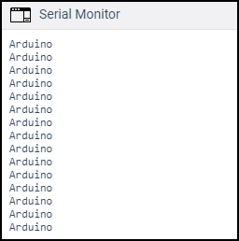
Output:

Slide 6
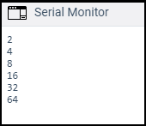
Example 2: To use a multiplication increment
The multiplication increment in the for loop will generate a logarithmic progression. Consider the below code:
1. int x;
void setup ( ) {
3. Serial.begin(9600);
4. for (x = 2; x < 100; x = x * 2) {
Serial.println(x);
}
7. }
void loop ( ) { }
Output:
We can also declare the int data type directly in the for loop. For example,
1. for (int x = 2; x < 100; x = x * 2)

Slide 7
Example 3: To fade an LED
Here, fade and LED means that LED will faint slowly. Consider the below code:
const int pinPWM = 11; // here, we have initialized the PWM pin.
void setup( ) {
3. Serial.begin(9600);
4. }
void loop ( ) {
int x = 1;
for (int i = 0; i > -1; i = i + x) {
analogWrite(pinPWM, i);
if (i == 255) {
x = -1; // It will switch the direction at peak }
delay(10); // It is delay time of 10 milliseconds
// the lesser the time, the more fading effect can be seen clearly
}
}

Slide 8
For the connection, we will connect the positive terminal of the LED in series with the resistor to PIN 11 (PWM pin), and the negative terminal of the LED to GND.
Note: The for loops in C++ programming language is much more flexible than other types of
programming languages.

Slide 9
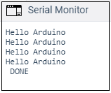
Example 4:
Consider the below code:
1. void setup ( ) {
int i;
Serial.begin(9600);
for (i=0; i<4; i= i+1) {
5. Serial.println( "Hello Arduino" );
6. }
7. Serial.println( " DONE");
8. }
9. void loop ( ) { }
The above code will print 'Hello Arduino' four times. After that the condition becomes false, control comes out of the loop, and 'DONE' is printed.
Output:

Slide 10
Arduino while loop
The while loop() is the conditional loop that continues to execute the code inside the parentheses
until the specified condition becomes false. The while loop will never exit until the tested condition is changed or made to stop. The common use of a while loop in Arduino includes sensor testing, calibration (calibrating the input of sensor), variable increment, etc.
The syntax is:
1. while (condition)
2. {
3. // code or set of statements
4. }
where condition: It specifies the boolean expression, which determines the condition to be true or false.

Slide 11
For example,
variable = 0;
while (variable < 100) {
// performs the specified task 100 times repeatedly
variable++; // increments after every execution
5. }
The above code inside the curly braces in while loop will execute continuously and repeatedly as long as the variable is less than 100.

Slide 12
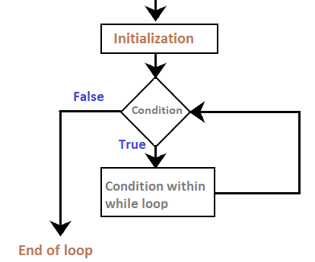
Flowchart
The flowchart is shown below:

Slide 13
Code Examples
In order to change the flow of the program, we need to change the specified condition inside the
parentheses of while loop. The process is much like the if statement.
Example 1:
Consider the below code:
int a = 0;
void setup()
{
Serial.begin(9600);
while( a < 5) {
6. Serial.println("Welcome to Arduino");
7. a = a + 1;
}
void loop() { }

Slide 14
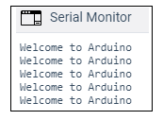
Output:
The message inside the loop will be printed five times, as shown below:
Explanation: At first, we have defined the variable a as 0, and initialized the serial monitor as usual (means Serial.begin()). The loop first checks the condition specified within the parentheses. At first, a =0. The condition is true (0 < 5). The code inside the curly braces will execute, and the message is printed. Now, the value of a is incremented (added 1 to a), and the loop executes again.
Similarly, five times the condition remains true. When a =5, the condition becomes false, and the loop exits and drops. The code outside the loop is executed.

Slide 15
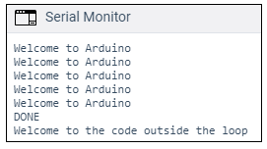
Example 2:
The code is similar to the above example. We will only add some statements outside the loop. Consider the below code:
int a = 0;
void setup() {
Serial.begin(9600);
while( a < 5) {
5. Serial.println("Welcome to Arduino");
6. a = a + 1;
7. }
Serial.println("DONE");
Serial.println("Welcome to the code outside the loop");
}
void loop() { }
Output:

Slide 16
do...while
The working of the do-while loop is similar to the while loop. The condition inside the do-while
will execute at least once. It is because the condition is tested at the end of the loop instead of the beginning.
The syntax is:
1. do
2. {
// code or set of statements
} while (condition);
where,
condition: It specifies the boolean expression, which determines the condition to be true or false.

Slide 17
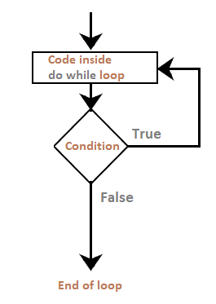
For example,
1. int b = 0;
2. do {
delay(100); // wait for stabilization of the sensors
b=readSensors(); // It checks the sensors
} while (x < 100); // specified condition
Flowchart
The flowchart is shown below:

Slide 18
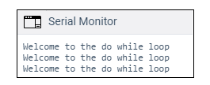
Code Example
Let's understand the concept of the do-while loop with an example.
Example 1:
int a = 0;
void setup() {
Serial.begin(9600);
do {
5. Serial.println("Welcome to the do while loop");
6. a = a + 1;
7. } while( a < 3);
8. }
void loop() { }
Output:

Slide 19
Arduino switch case
The switch case controls the flow of the program by executing the code in various cases. A
switch statement compares a particular value of a variable with statements in other cases. When
the statements in a case matches the value of a variable, the code associated with that case executes.
The break keyword is used at the end of each case. For example, if there are five cases, the break statements will also be five. The break statement exits the switch case.
The switch statement without a break will continue to execute all the cases until the end. Hence, it is essential to include a break statement at the end of each case.

Slide 20
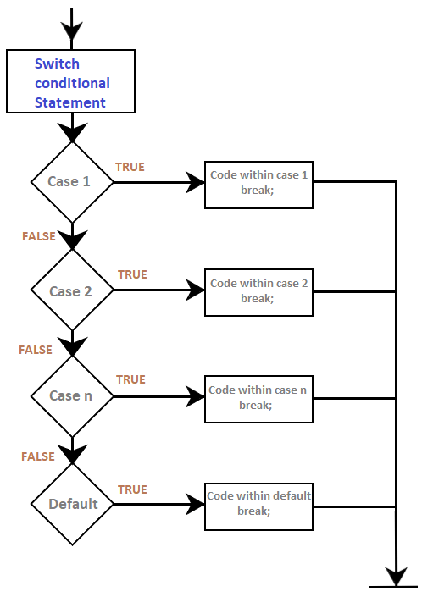
Flowchart of the switch case

Slide 21
1. switch(variable)
2. {
case 1: // statements related to case1
break;
case 2: // statements related to case2
break;
.
.
case n:
// statements related to case n
break;
default: // it contains the optional code
//if nothing matches in the above cases, the default statement runs
break; }

Slide 22
where,
variable: It includes the variables whose value will be compared with the multiple cases
value: It consists of a value to compare. These values are constants. The allowed data types are int and char.
Can we use the if statement instead of a switch case?
Yes.
But for some cases, implementing a switch case is somewhat easier than if statements. It is recommended to use switch cases instead of if statement when multiple conditions of a non- trivial expression are being compared.
The if statement allows us to choose between the two options, TRUE or FALSE. We can also use multiple if statements for more than two cases. The switch case allows us to choose between various discrete options.

Slide 23
Code Example
We will include the switch case in the setup() function, as we do not require the repeated execution.
void setup() {
Serial.begin(9600);
int a = 1;
switch(a) // the case matching the value in the declared variable will run {
case 1: Serial.println(" Case 1 matches");
// the value of variable matches with the value in case 1.
// The message associated with case 1 will be printed
break;
case 2: Serial.println(" Case 2 matches");
break;
case 3: Serial.println(" Case 3 matches");
break;

Slide 24
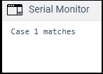
13. default: Serial.println(" default matches");
break;
}
}
void loop() { }
Output:

